Slide 1
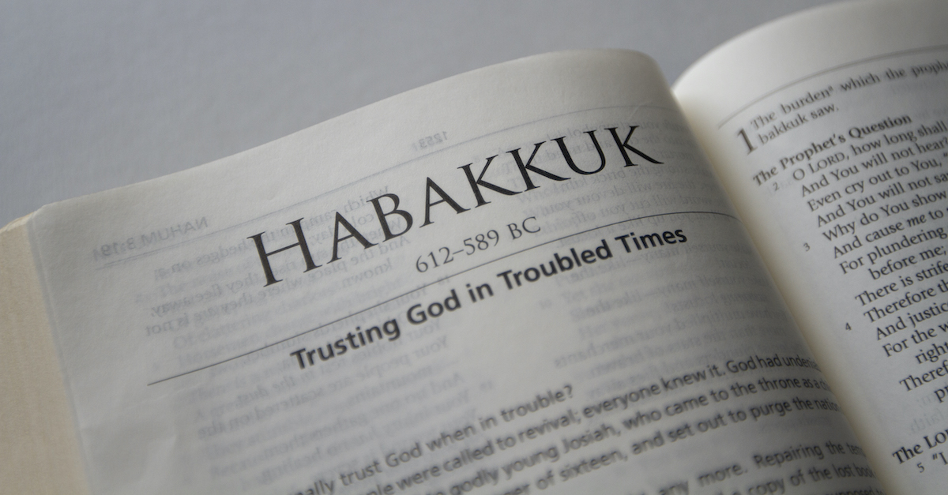
Chapter 3

Slide 2
How can he do that?

Slide 3
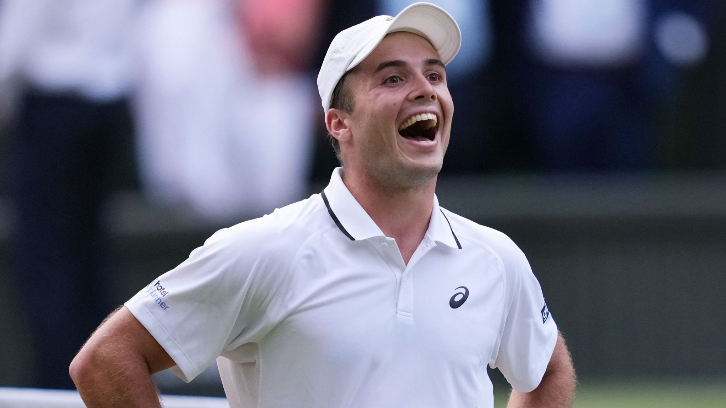

Slide 4
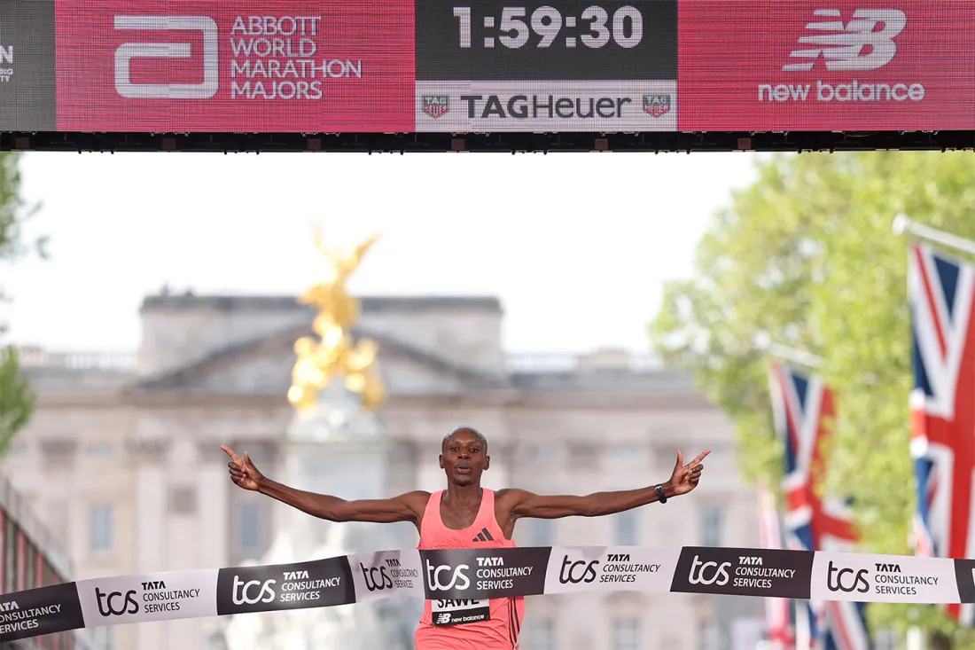

Slide 5


Slide 6
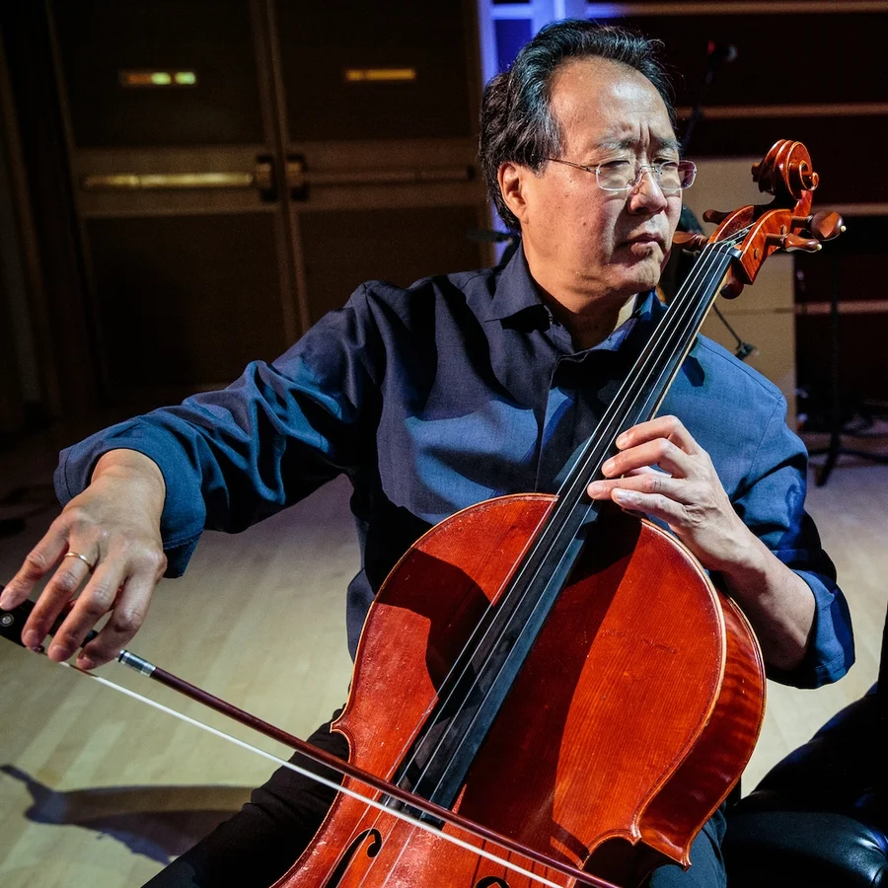

Slide 7
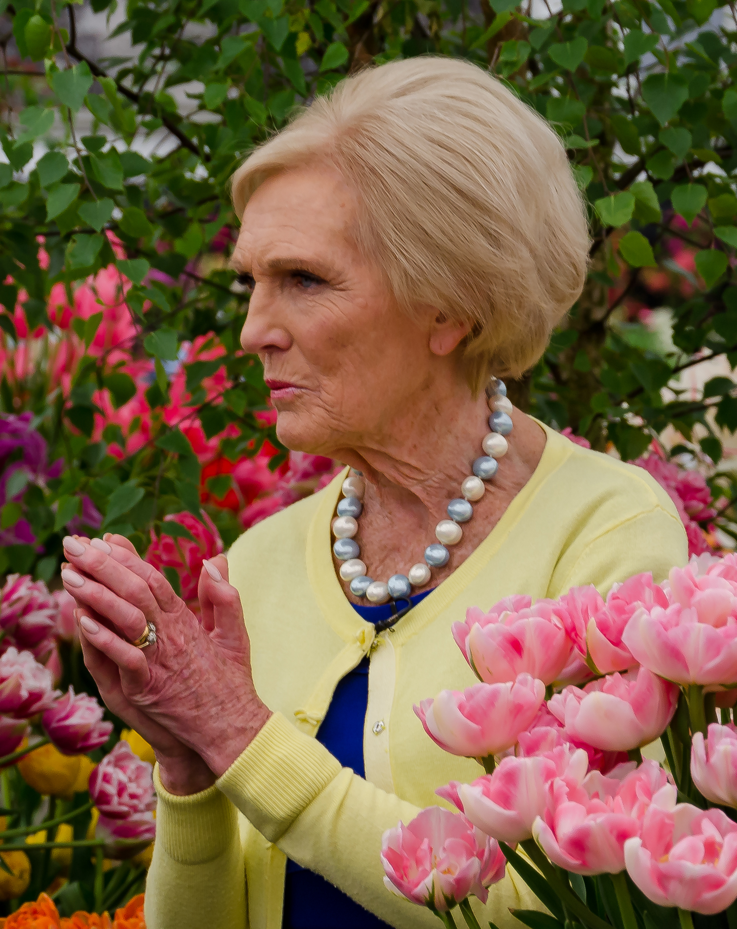

Slide 8
How can he do that?

Slide 9
Chapter 3

Slide 10
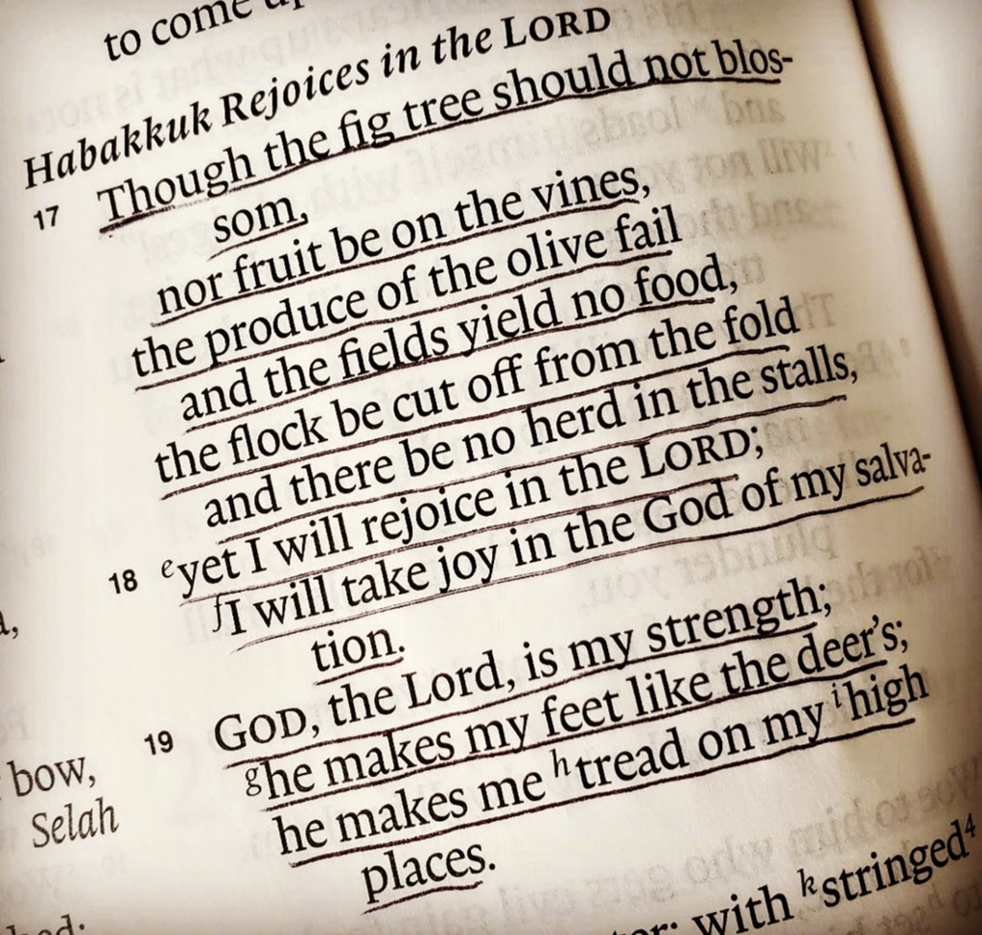

Slide 11
How can he do that?

Slide 12
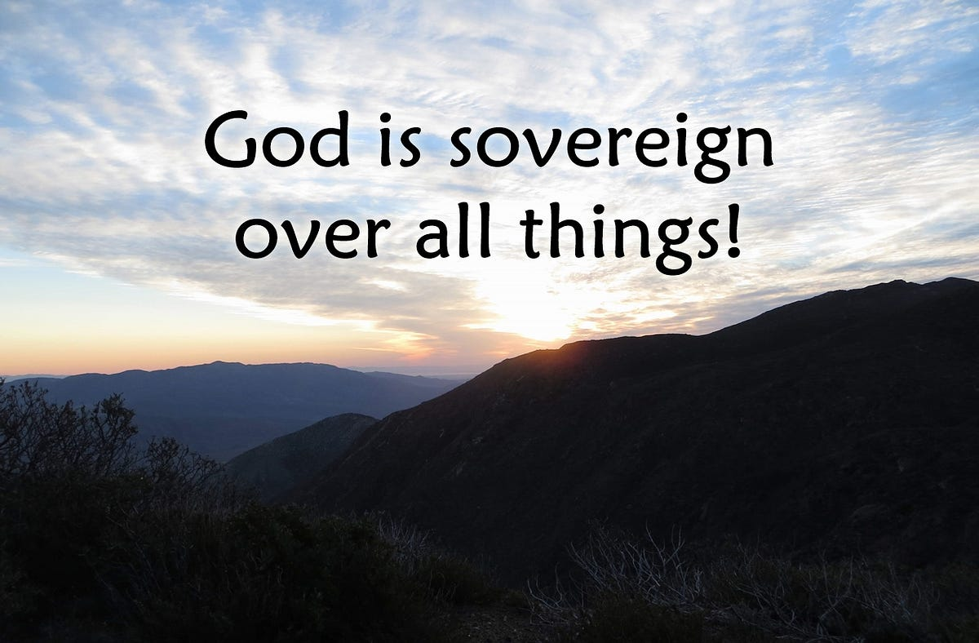

Slide 13
How can I do this?

Slide 14
Though ….
Yet
I will rejoice in the Lord
I will be joyful in God my Saviour

Slide 15
